Slide 1
Security
DT211/DT228/3
Dr. Yupeng Liu

Slide 2
Course Outline
Introduction to cryptography
Number theory
Symmetric and Asymmetric Cryptography
Public-Key Cryptography and RSA, Key management,
Steganography
Network, Internet Security, ethical hacking
System Security
Electronic Mail Security, Firewalls.
Virus, Worms etc
Notes:
Basic principles and simpler encryption mechanisms
Branch of mathematics, deals with whole numbers, we’ll have a look at prime numbers
Same or different process for encryption and decryption
How to share a key?
Concealing information in files
Ethical hacking has a good purpose, used for testing network security
Protection from various malware

Slide 3
References
Cryptography and Network Security : Principles and Practices, 5th Ed, Williams Stallings (2011) Prentice Hall.
Network Security Essentials: Applications and Standards, 4th Ed, William Stallings (2011), Prentice Hall.
Network perimeter Security: Building Defense In-Depth, Cliff Riggs (2003), Auerbach Publications.
Notes:
Some additional textbook recommendations for digging deeper

Slide 4
The future of Security threats
Cyberwar declared – Stuxnet a politically motivated attack (weaponized malware)
Advanced Persistent Threat (APT) – advanced malware attack
VoIP attacks – brute force and directory traversal class attacks against VoIP servers
Notes:
Future of security threats is expected to have a big scale:
example: Stuxnet is a malicious computer worm, first uncovered in 2010. Thought to have been in development since at least 2005, Stuxnet targets SCADA systems and is believed to be responsible for causing substantial damage to Iran's nuclear program. Although neither country has openly admitted responsibility, the worm is believed to be a jointly built American/Israeli cyberweapon.
An advanced persistent threat (APT) is a stealthy computer network attack in which a person or group gains unauthorized access to a network and remains undetected for an extended period. The term's definition was traditionally associated with nation-state sponsorship, but over the last few years we’ve seen multiple examples of non-nation state groups conducting large-scale targeted intrusions for specific goals.
VoIP is vulnerable to similar types of attacks that Web connection and emails are prone to. VoIP attractiveness, because of its low fixed cost and numerous features, come with some risks that are well known to the developers an are constantly being addressed. But these risks are usually not mentioned to the business which is the most common target. VoIP also allows the use of fraud and shady practices that most people are not aware of. And while this practices are restricted by most providers, the possibility that someone is using them for his own gain still exists.

Slide 5
The future of Security threats
Car hacking – cars are more connected with built-in Bluetooth, 3G internet, GPS, Onstar, and dashboard computers
The Facebook challenge - users trust of web
Manufactured-delivered malware – products arriving with infections out of the box
DLP for IP – shift from physical to digital production.
Notes:
Car hacking is the manipulation of the code in a car's electronic control unit (ECU ) to exploit a vulnerability and gain control of other ECU units in the vehicle.
Should we trust big companies with our data? How much information do we want to reveal and give out for free?
Computer manufacturers are offered money from other companies to pre-install malware on new computers
Data loss prevention software detects potential data breaches/data ex-filtration transmissions and prevents them by monitoring, detecting and blocking sensitive data while in-use (endpoint actions), in-motion (network traffic), and at-rest (data storage).

Slide 6
Cybercrime Knows No Borders
Prosecuting cybercrime is no easy task
Legal inadequacies in various jurisdictions
Uneven enforcement
Fighting internet crime does not come cheap. For example, cyber intrusions cost the British economy $43 Billion annually.
The Cyber industrial complex is emerging, which is very similar to the military industrial complex of the cold war.
Notes:
Cybercrime is a fast-growing area of crime. More and more criminals are exploiting the speed, convenience and anonymity of the Internet to commit a diverse range of criminal activities that know no borders, either physical or virtual, cause serious harm and pose very real threats to victims worldwide.

Slide 7
Steps for Cloud Security
Take responsibility for your own security
Ring fence your data
Think about encryption
Strong passwords for cloud services
Consider making your user devices ‘dumb’
Notes:
Cloud security is the protection of data, applications, and infrastructures involved in cloud computing. ... High-level security concerns—like unauthorized data exposure and leaks, weak access controls, susceptibility to attacks, and availability disruptions—affect traditional IT and cloud systems alike.

Slide 8
Common Sense Security
Security is not a specialist subject – it’s everyone’s responsibility
The attackers only have to get lucky once and the defenders have to get it right 100% of the time
Notes:
Use alternative search engines
Strong passwords with regular changes
VPNs
Lock your devices
Update security software
Use disposable email
Be prepared for emergency
Limit online financial activities
View email as plain text

Slide 9
Why Cryptography?
Defense in Depth
Notes:
Defense in depth (also known as Castle Approach^{[1]} is an information assurance (IA) concept in which multiple layers of security controls (defense) are placed throughout an information technology (IT) system. Its intent is to provide redundancy in the event a security control fails or a vulnerability is exploited that can cover aspects of personnel, procedural, technical and physicalsecurity for the duration of the system's life cycle.

Slide 10
The Adversarial Setting
The biggest difference between security systems and any other engineering is the adversarial setting.
Factors such as storms, heat, wear and tear are fairly predictable to an experienced engineer.
In security systems opponents are intelligent, clever, malicious and devious. They do things nobody ever thought before, do not play by the rules and are completely unpredictable.
Notes:
The problem in security in most cases is not engineering, but the unpredictability of the opponent.

Slide 11
Professional Paranoia
To work in this field, you have to become devious yourself.
You have to think like a malicious attacker to find weaknesses in your own work.
Cryptographers are professional paranoids.
Developing this mindset (security mindset) will help you observe things about systems and your environment that most other people do not notice
Notes:
In the world of digital security, it’s valuable to develop a certain level of professional paranoia. Essentially, even if no one is actively trying to hack or exploit your system, always assume that nefarious individuals exist and will attack you in the future.

Slide 12
Why Cryptography?
Cryptography can be compared to locks in the Physical world. A lock by itself is a singularly useless thing.
Cryptography is just a small part of a much larger security system.
Notes:
Until modern times, cryptography referred almost exclusively to encryption, which is the process of converting ordinary information (called plaintext) into unintelligible form (called ciphertext). Decryption is the reverse, in other words, moving from the unintelligible ciphertext back to plaintext.

Slide 13
Why Cryptography?
Cryptography as a Mathematical Science vs Cryptography as an Engineering discipline.
Security is only as strong as the weakest link, and the Mathematics of Cryptography is almost never the weakest link.
Notes:
The maths of cryptography is well-known and tested. We know what we need in theory to make a system unbreakable in reasonable time. But what produces leaks is the engineering part. The system that we build around cryptography and the human component.

Slide 14
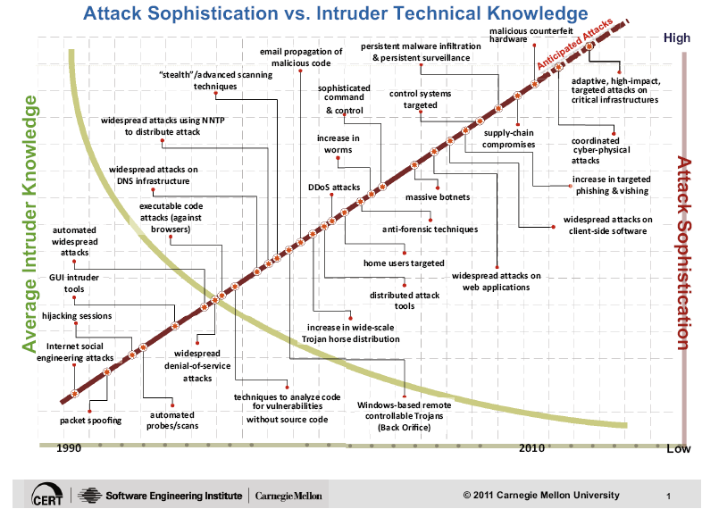
The Evolution of attack techniques/technologies
Notes:
The level of knowledge required by intruders is getting steadily lower, yet their ability to perpetrate sophisticated attacks against the survivability of systems has increased.
Contributing factors include:
Explosion of computer and Internet availability
Increase in broadband availability in residential areas
Low priority of security for software developers
Difficulty patching vulnerabilities on all systems
Graphical user interface (GUI) based tools that exploit known software vulnerabilities
Availability of "malware" (malicious software) authoring/editing tools
Introduction of tools that attempt to exploit multiple vulnerabilities (i.e., Nimda)

Slide 15
Security Threats
Spyware and Ad ware
Viruses
Phishing and Pharming
Worms, Bots
SQL injection
Sophisticated targeted attacks
Politically motivated attacks (Weaponized malware) - Stuxnet
Notes:
Malware: Malware is short for “malicious software.” Wikipedia describes malware as a term used to mean a “variety of forms of hostile, intrusive, or annoying software or program code.” Malware could be computer viruses, worms, Trojan horses, dishonest spyware, and malicious rootkits—all of which are defined below.
Computer virus: A computer virus is a small piece of software that can spread from one infected computer to another. The virus could corrupt, steal, or delete data on your computer—even erasing everything on your hard drive. A virus could also use other programs like your email program to spread itself to other computers.
Rogue security software: Have you ever seen a pop-up window that advertises a security update or alert? It appears legitimate and asks you to click on a link to install the “update” or “remove” unwanted malicious software that it has apparently detected. This could be rogue security software designed to lure people into clicking and downloading malicious software. Microsoft has a useful webpage that describes rogue security software and how you can protect yourself.
Trojan horse: Users can infect their computers with Trojan horse software simply by downloading an application they thought was legitimate but was in fact malicious. Once inside your computer, a Trojan horse can do anything from record your passwords by logging keystrokes (known as a keystroke logger) to hijacking your webcam to watch and record your every move.
Malicious spyware: Malicious spyware is used to describe the Trojan application that was created by cybercriminals to spy on their victims. An example would be keylogger software that records a victim’s every keystroke on his or her keyboard. The recorded information is periodically sent back to the originating cybercriminal over the Internet. Keylogging software is widely available and is marketed to parents or businesses that want to monitor their kids’ or employees’ Internet usage.
Computer worm: A computer worm is a software program that can copy itself from one computer to another, without human interaction. Worms can replicate in great volume and with great speed. For example, a worm can send copies of itself to every contact in your email address book and then send itself to all the contacts in your contacts’ address books.
Botnet: A botnet is a group of computers connected to the Internet that have been compromised by a hacker using a computer virus or Trojan horse. An individual computer in the group is known as a “zombie“ computer.
Spam: Spam in the security context is primarily used to describe email spam —unwanted messages in your email inbox. Spam, or electronic junk mail, is a nuisance as it can clutter your mailbox as well as potentially take up space on your mail server. Unwanted junk mail advertising items you don’t care for is harmless, relatively speaking. However, spam messages can contain links that when clicked on could go to a website that installs malicious software onto your computer.
Phishing: Phishing scams are fraudulent attempts by cybercriminals to obtain private information. Phishing scams often appear in the guise of email messages designed to appear as though they are from legitimate sources. For example, the message would try to lure you into giving your personal information by pretending that your bank or email service provider is updating its website and that you must click on the link in the email to verify your account information and password details.
Rootkit: According to TechTarget, a rootkit is a collection of tools that are used to obtain administrator-level access to a computer or a network of computers. A rootkit could be installed on your computer by a cybercriminal exploiting a vulnerability or security hole in a legitimate application on your PC and may contain spyware that monitors and records keystrokes.

Slide 16
Security Certification
International Information Systems Security Certification Consortium (ISC)²
Certified Information System Security Professional (CISSP)
Global Information Assurance Certification
Cisco Certified Security Professional (CCSP)
etc
Notes:
Security is more important to computing and the internet than ever before, and the following, well-respected security certs will not only help you stand out from the crowd, but also make you a more valuable member of the IT security community.

Slide 17
It’s going to get worse - 1
Explosive growth of the Internet continues
continues to double in size every 10-12 months
where will all the capable system administrators come from?
Market growth will drive vendors
time to market, features, performance, cost are primary
“invisible” quality features such as security are secondary
Notes:
From an industry perspective the security situation is going to get worse.

Slide 18
It’s going to get worse - 2
More sensitive applications connected to the Internet
low cost of communications, ease of connection, and power of products engineered for the Internet will drive out other forms of networking
hunger for data and benefits of electronic interaction will continue to push widespread use of information technology
Notes:
More online communication and more data means more opportunity to spy and steal data.

Slide 19
It’s going to get worse - 3
The death of the firewall
traditional approaches depend on complete administrative control and strong perimeter controls
today’s business practices and wide area networks violate these basic principles
no central point of network control
more interconnections with customers, suppliers, partners
more network applications
“the network is the computer”
who’s an “insider”and who’s an “outsider”
Notes:
In a new approach to enterprise security, Google is jettisoning the traditional firewall in favour of a model where the data exists in the cloud but can only be accessed by the right devices with the right credentials.

Slide 20
Before it gets better - 1
Strong market for security professionals will eventually drive graduate and certificate programs.
Increased understanding by technology users will build demand for quality security products; vendors will pay attention to the market.
Insurance industry will provide incentives for improved business security practices.
Notes:
Job market for security experts is expected to boom in the near future.

Slide 21
Before it gets better - 2
Technology will continue to improve and we will figure out how to use it
encryption
strong authentication
survivable systems
Increased collaboration across government and industry.
Notes:
an analysis language called EASEL, which aids in determining the survivability of critical systems through the use and creation of emergent simulations.

Slide 22
Good news
Our research has shown pay for information security and security jobs, skills and certifications have been above average for two years straight … The writing is on the wall: If you are not in that business, you might want to point your career toward that …. Security has not been a sexy place to work. It has not been funded well. But clearly when the smoke clears it will be funded, and it will be funded well.
Source: David Foote – President and chief research officer at Foote partners (www.footepartners.com)
Notes:
A career in computer security might be a good option.
Foote Partners: IT salary and skills pay benchmark surveys and market intelligence for US and Canada.

Slide 23
Computer Security
Definition: the protection afforded to an automated information system in order to attain the applicable objectives of preserving the integrity, availability and confidentiality of information system resources (includes hardware, software, firmware, information/data, and telecommunications)
Notes:
The NIST Computer Security Handbook [NIST95] defines the term computer security as shown on this slide. This definition introduces three key objectives that are at the heart of computer security as we see on the next slide.

Slide 24
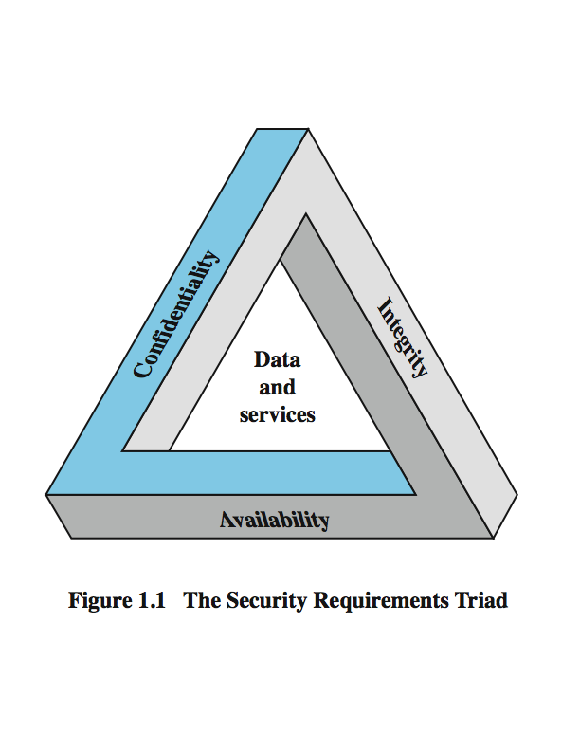
Key Security Concepts
Notes:
These three concepts form what is often referred to as the CIA triad (Figure 1.1). The three concepts embody the fundamental security objectives for both data and for information and computing services. FIPS PUB 199 provides a useful characterization of these three objectives in terms of requirements and the definition of a loss of security in each category:
• Confidentiality (covers both data confidentiality and privacy): preserving authorized restrictions on information access and disclosure, including means for protecting personal privacy and proprietary information. A loss of confidentiality is the unauthorized disclosure of information.
• Integrity (covers both data and system integrity): Guarding against improper information modification or destruction, and includes ensuring information non-repudiation and authenticity. A loss of integrity is the unauthorized modification or destruction of information.
• Availability: Ensuring timely and reliable access to and use of information. A loss of availability is the disruption of access to or use of information or an information system.
Although the use of the CIA triad to define security objectives is well established, some in the security field feel that additional concepts are needed to present a complete picture. Two of the most commonly mentioned are:
• Authenticity: The property of being genuine and being able to be verified and trusted; confidence in the validity of a transmission, a message, or message originator.
• Accountability: The security goal that generates the requirement for actions of an entity to be traced uniquely to that entity.

Slide 25
Levels of Impact
can define 3 levels of impact from a security breach
Low
Moderate
High
Notes:
We can define three levels of impact on organizations or individuals should there be a breach of security (i.e., a loss of confidentiality, integrity, or availability). These levels are defined in FIPS PUB 199:
• Low: The loss could be expected to have a limited adverse effect on organizational operations, organizational assets, or individuals. A limited adverse effect means that, for example, the loss of confidentiality, integrity, or availability might (i) cause a degradation in mission capability to an extent and duration that the organization is able to perform its primary functions, but the effectiveness of the functions is noticeably reduced; (ii) result in minor damage to organizational assets; (iii) result in minor financial loss; or (iv) result in minor harm to individuals.
• Moderate: The loss could be expected to have a serious adverse effect on organizational operations, organizational assets, or individuals. A serious adverse effect means that, for example, the loss might (i) cause a significant degradation in mission capability to an extent and duration that the organization is able to perform its primary functions, but the effectiveness of the functions is significantly reduced; (ii) result in significant damage to organizational assets; (iii) result in significant financial loss; or (iv) result in significant harm to individuals that does not involve loss of life or serious, life-threatening injuries.
• High: The loss could be expected to have a severe or catastrophic adverse effect on organizational operations, organizational assets, or individuals. A severe or catastrophic adverse effect means that, for example, the loss might (i) cause a severe degradation in or loss of mission capability to an extent and duration that the organization is not able to perform one or more of its primary functions; (ii) result in major damage to organizational assets; (iii) result in major financial loss; or (iv) result in severe or catastrophic harm to individuals involving loss of life or serious life threatening injuries.

Slide 26
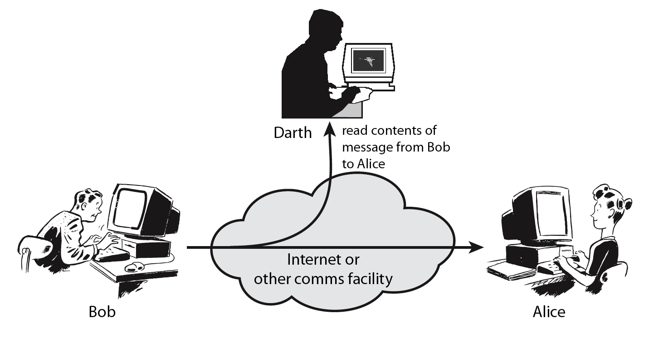
Passive Attacks
Notes:
A useful means of classifying security attacks, used both in X.800 and RFC 2828, is in terms of passive attacks and active attacks. A passive attack attempts to learn or make use of information from the system but does not affect system resources.
Passive attacks are in the nature of eavesdropping on, or monitoring of, transmissions. The goal of the opponent is to obtain information that is being transmitted. Two types of passive attacks are:
+ release of message contents - as shown above in Stallings Figure 1.2a here
+ traffic analysis - monitor traffic flow to determine location and identity of communicating hosts and could observe the frequency and length of messages being exchanged
These attacks are difficult to detect because they do not involve any alteration of the data.

Slide 27
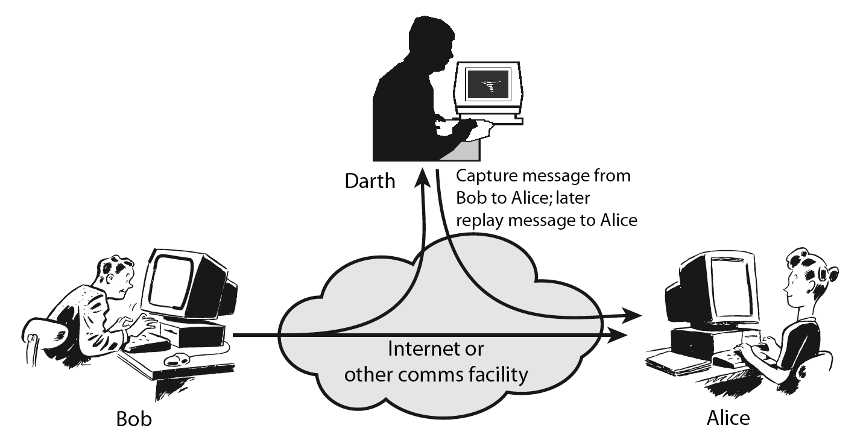
Active Attacks
Notes:
Active attacks involve some modification of the data stream or the creation of a false stream and can be subdivided into four categories: masquerade, replay, modification of messages, and denial of service:
masquerade of one entity as some other
replay previous messages (as shown above in Stallings Figure 1.3b)
modify/alter (part of) messages in transit to produce an unauthorized effect
denial of service - prevents or inhibits the normal use or management of communications facilities
Active attacks present the opposite characteristics of passive attacks. Whereas passive attacks are difficult to detect, measures are available to prevent their success. On the other hand, it is quite difficult to prevent active attacks absolutely, because of the wide variety of potential physical, software, and network vulnerabilities. Instead, the goal is to detect active attacks and to recover from any disruption or delays caused by them.

Slide 28
Security Mechanism
feature designed to detect, prevent, or recover from a security attack
no single mechanism that will support all services required
however one particular element underlies many of the security mechanisms in use:
cryptographic techniques
Notes:
Now introduce “Security Mechanism” which are the specific means of implementing one or more security services. Note these mechanisms span a wide range of technical components, but one aspect seen in many is the use of cryptographic techniques.

Slide 29
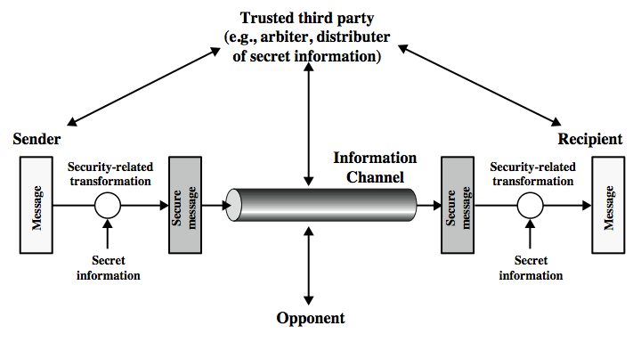
Model for Network Security
Notes:
In considering the place of encryption, its useful to use the following two models from Stallings section 1.6.
The first, illustrated in Figure 1.4, models information being transferred from one party to another over an insecure communications channel, in the presence of possible opponents. The two parties, who are the principals in this transaction, must cooperate for the exchange to take place. They can use an appropriate security transform (encryption algorithm), with suitable keys, possibly negotiated using the presence of a trusted third party. Parts One through Four of this book concentrates on the types of security mechanisms and services that fit into the model shown here.

Slide 30
Model for Network Security
using this model requires us to:
design a suitable algorithm for the security transformation
generate the secret information (keys) used by the algorithm
develop methods to distribute and share the secret information
specify a protocol enabling the principals to use the transformation and secret information for a security service
Notes:
This general model shows that there are four basic tasks in designing a particular security service, as listed.

Slide 31
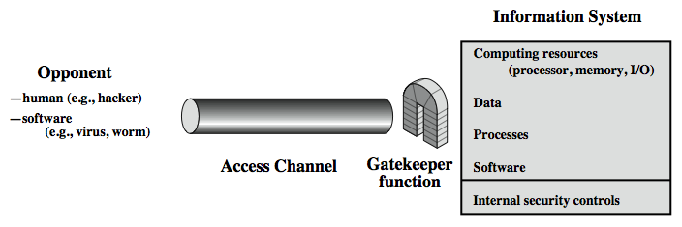
Model for Network Access Security
Notes:
The second, illustrated in Figure 1.5, model is concerned with controlled access to information or resources on a computer system, in the presence of possible opponents. Here appropriate controls are needed on the access to and within the system, to provide suitable security.
The security mechanisms needed to cope with unwanted access fall into two broad categories (as shown in this figure). The first category might be termed a gatekeeper function. It includes password-based login procedures that are designed to deny access to all but authorized users and screening logic that is designed to detect and reject worms, viruses, and other similar attacks. Once either an unwanted user or unwanted software gains access, the second line of defense consists of a variety of internal controls that monitor activity and analyze stored information in an attempt to detect the presence of unwanted intruders. These issues are explored in Part Four.

Slide 32
Model for Network Access Security
using this model requires us to:
select appropriate gatekeeper functions to identify users
implement security controls to ensure only authorised users access designated information or resources
Notes:
Detail here the tasks needed to use this model.

Slide 33
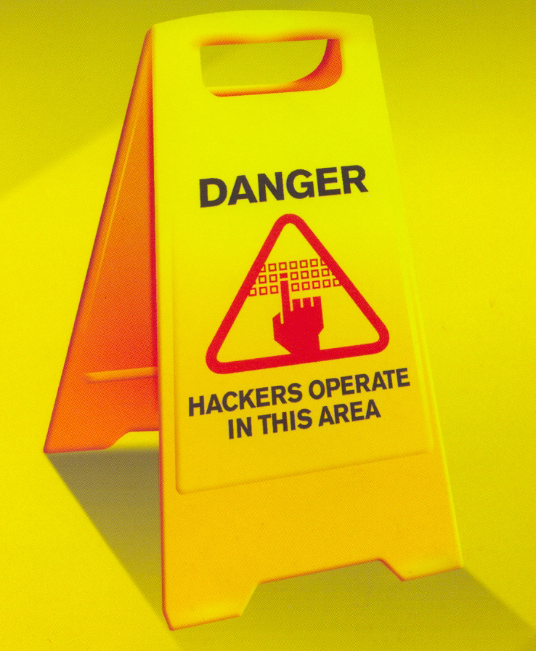
Security and Cryptography

Slide 34
The bottom line
You are all ‘digital natives’ and the rest of us are ‘digital immigrants’.
However, are you ‘digitally competent’
It was projected that by 2015 the professional ICT shortage in EU will be approximately 700,000
Source: Enterprise & Industry Magazine, European Commission, Issue 13, July 2012.
Notes:
Digital native: a person born or brought up during the age of digital technology and so familiar with computers and the Internet from an early age.
Digital immigrant: a person born or brought up before the widespread use of digital technology.
EU needs more than 1,000,000 ICT professionals

Slide 35
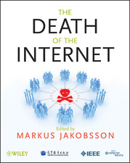

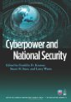


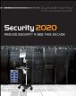
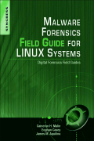





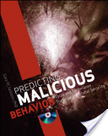
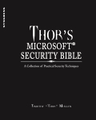



Security Books you may want to read

Slide 36
Caesar Cipher
Plaintext: the quick brown fox jumps over the lazy dog
Ciphertext: QEB NRFZH YOLTK CLU GRJMP LSBO QEB IXWV ALD
Key: ?

Slide 37
Decrypting Caesar
Decrypt the following message using key = 5:
YMNX BNQQ GJ UFWY TK YMJ KNSFQ JCFR. YMJWJKTWJ NY NX MNLMQD WJHTRRJSIJI YT YFPJ STYJX FSI RJRTWNXJ FX RZHM FX UTXXNGQJ. DTZ HFS YMFSP DTZW NSXYW ZHYTW QFYJW.
Find the key to the following message:
MBIZDYQBKZRI

Slide 38
Vigènere Cipher
Plaintext: attack at dawn
Key: lemon
Ciphertext: LXFOPVEFRNHR

Slide 39
Decypting Vigènere
Decrypt the following message using key = MOBY:
FVFPQ OSC OSSRMWO OGSFP FWNCE OOB AQDYEWPLE WO RTWT QFFBLSS NGJSE YRTBGD KF AMZM JUTF UTSO Y YOO RMYFQ FVJQ IVPJQ IOGHSSQQ TPP M JBQF DSYOHJAMZ KMWS, UFAIHF FVF UUH UFQFFMR VF ZGH EGYZZ BUGDCDBT, YZR NMDS UFMB TSEDFAFG UFMH UFQ XPIQ WT YF BPZARZ'Q QLQCZGF ZGH IGE CXL.

